Slide 1

Internship Summery
Performed At
Making Technology Work
for you
Md Jamilur Rahman
Registration No: 2018831035
Department of Software Engineering
Institute of Information and Communication Technology
Shahjalal University of Science and Technology
Duration:
12th February - 31 July

Slide 2


Company Introduction
Dynamic Solution Innovators

Slide 3



Overview
฀ A software company providing services to global industry since 2001.
฀ Packed with 250+ sophisticated engineers.
Have 2 Branches, one in new Mohakhali DOHS and another one in the United States of America.
Winner of BASIS ICT AWARD 2020. ฀
Member of BASIS (Bangladesh Association of Software And Information Service) and BMCCI (Bangladesh-Malaysia Chamber of Commerce and Industry). ฀
Certified by ISO/IEC 27001:2013.

Slide 4
Services DSi Provides
UX Design
Embedded System Design
Big Data & Data Science ฀
Mobile Application ฀
Cloud Services
DevOps Services ฀
Software Quality Assurance ฀
Database Management ฀
Highly Scalable System Design

Slide 5
Major Projects of DSi
ODMS: ERP solution for container and cargo management. ฀
OpenCRVS: Open source global solution for civil registration. ฀
Jenzabar: Cloud based enterprise solution for higher education. ฀
Olwel: Integrated healthcare service delivery platform. ฀
Banking Compliance System: Online banking solution used by 200 financial institutions. ฀
TTMS (Teacher Transfer Management System): A national scale project for the Directorate of Primary Education (DPE). ฀
IPEIMS (Integrated Primary Educational Information Management System): A comprehensive education management system for digitizing primary education sector. ฀
Recenso: Document management system used by US Attorneys. ฀
Integrated Service Delivery Platform: Connects 2800+ government digital service in a central hub.

Slide 6

Verticals DSi Contribues
Healthcare ฀
Banking ฀
Document Discovery ฀
Digital Verification ฀
Off-Dock ฀
Government ฀
Higher Education
Customer Partenrs

Slide 7
Employment Facilities
Festival Bonus ฀
Marriage Bonus ฀
Buffet lunch ฀
Yearly Increment ฀
Flexible Working Hour ฀
Indoor Games ฀
Annual Retreat ฀
Paid Maternity Leave ฀
Cozy Environment

Slide 8
Internship Activities

Slide 9














FTP Server
Interview
Management System
OpenCRVS

Slide 10
Phase One
Masum vai ( CTO of DSi) was our mentor
We studied:
RFC 1945 - http/1.0
Network communication (OSI, tcp/ip)
Each of us individually built an ftp server using nodeJs

Slide 11
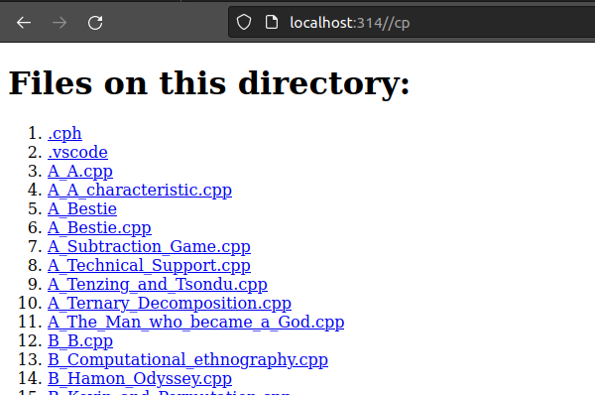
Phase One

Slide 12
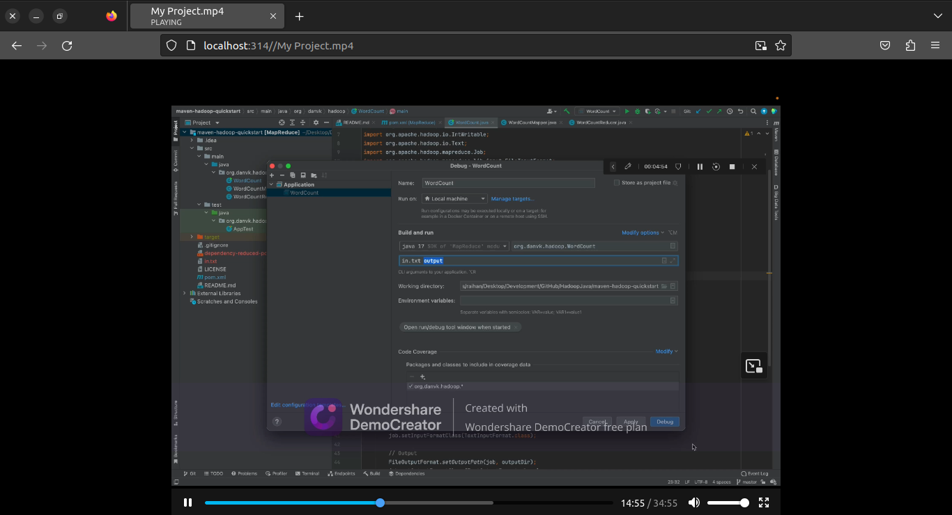
Phase One

Slide 13
Phase One
Challenge(s):
Before serving a file, we need to know if the file exists or if the server has read access to the file. We can easily check these information using fs. But what if there is a race condition - when we check the file, we see that the file exists and we have read access to it, so we proceed to read the file. But before we could do that, some other programme deleted the file or altered it's access. Now we can't read the file.

Slide 14
Phase One
Challenge(s):
Before serving a file, we need to know if the file exists or if the server has read access to the file. We can easily check these information using fs. But what if there is a race condition - when we check the file, we see that the file exists and we have read access to it, so we proceed to read the file. But before we could do that, some other programme deleted the file or altered it's access. Now we can't read the file.
Solution: Error handling

Slide 15
Phase Two
We engaged in informative sessions covering various aspects of software engineering with seasoned engineers:
Overview of web technology
Web architectures: Monolithic, Microservice, Scaling
Backend technologies
Frontend technologies
Thought process for choosing the approprirate architecture and technology
We worked on a demo project:
Interview management system

Slide 16
Phase Two
Interview Management System
Microservice architecture
Frontend :
NextJs( React )
antDesign
Backend:
ExpressJs
.Net
springboot
Database:
The database is shared

Slide 17
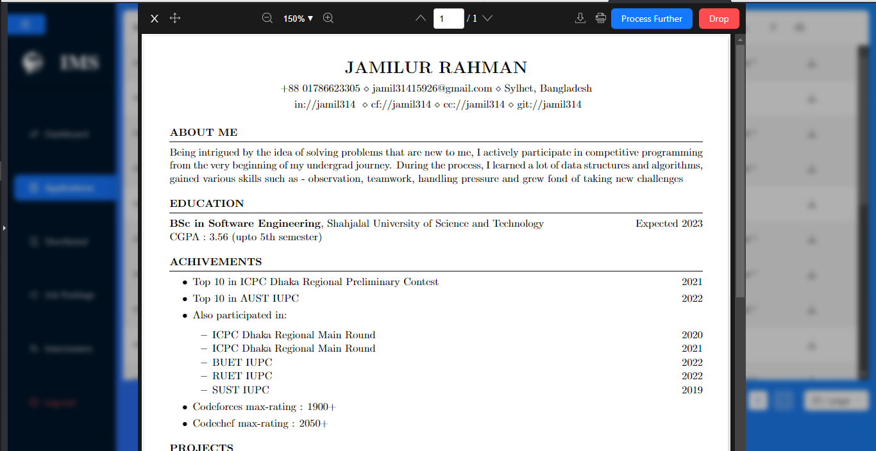
Phase Two
Interview Management System

Slide 18
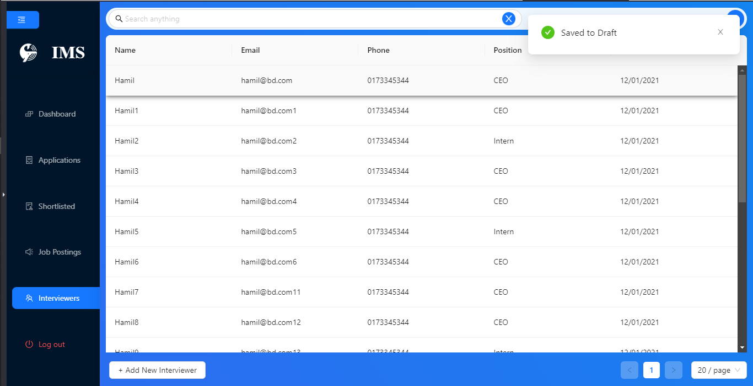
Phase Two
Interview Management System

Slide 19
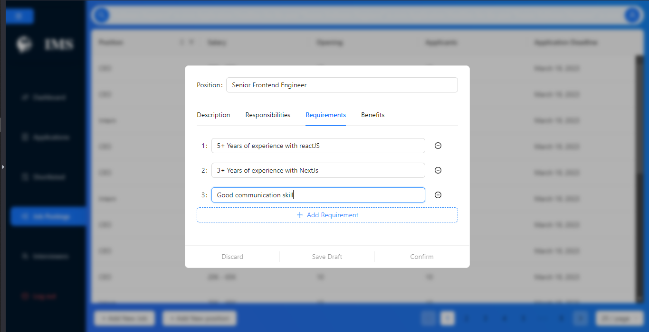
Phase Two
Interview Management System

Slide 20
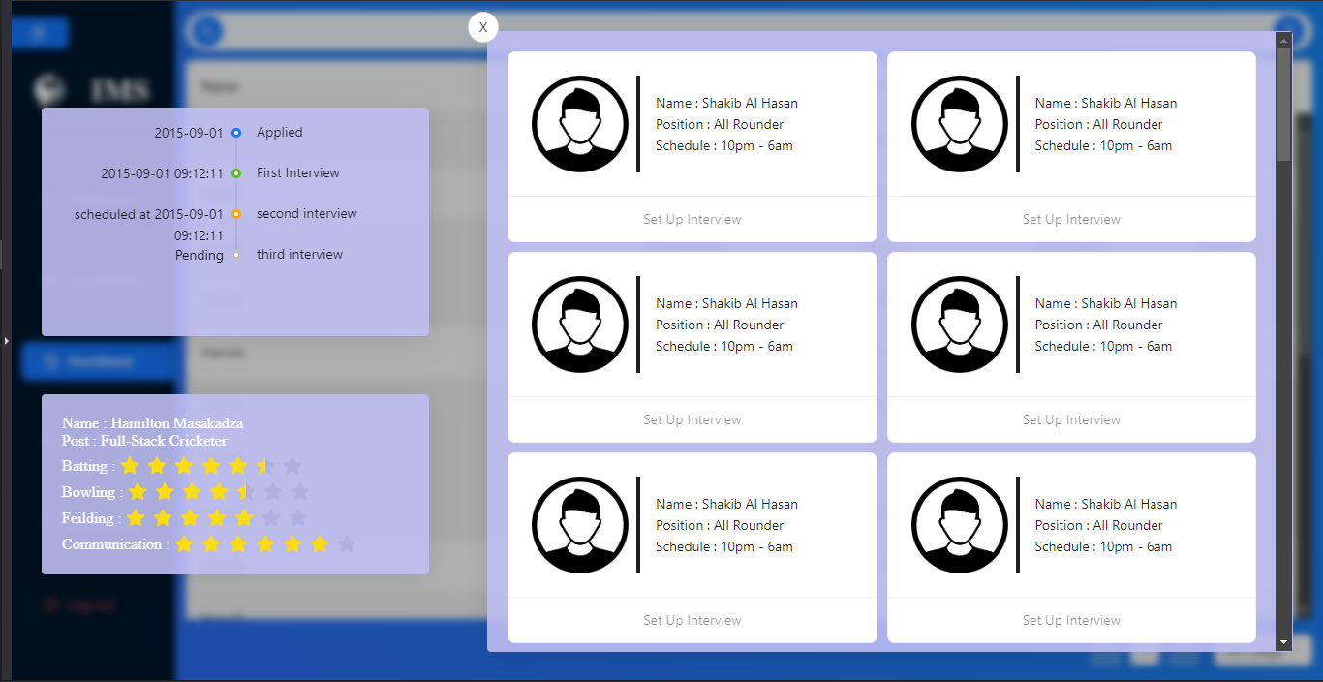
Phase Two
Interview Management System

Slide 21
Phase Three
I was assigned to team OpenCRVS
An open source platform for civil registration and vital statistics
Records and analyzes birth, death, marriage etc events of the citizens
Total of 14 onshore and offshore engineers
Multirepository Microservice architecture
Two repos:
Core
Login, client, auht, gateway, user-mgnt, document etc.
Country config

Slide 22
Phase Three
Login
Client

Slide 23
Phase Three
Login
Auth
Client

Slide 24
Phase Three
Login
Auth
Client
Gateway

Slide 25
Phase Three
Login
Auth
Client
Gateway
Data seeder

Slide 26
Phase Three
Login
Auth
Client
Gateway
Workflow
Data seeder

Slide 27
Phase Three
User-mgnt
Login
Auth
Metrics
Client
Gateway
Workflow
Document
Search
Data seeder
Notification

Slide 28
Hearth
Phase Three
OpenHIM
User-mgnt
Login
Auth
Metrics
Client
Gateway
Workflow
Document
Minio
IndexedDb
Search
Elastic
search
Data seeder
Notification

Slide 29
Hearth
Phase Three
OpenHIM
User-mgnt
Login
Auth
Metrics
Client
Gateway
Workflow
Document
Minio
IndexedDb
GraphQL
(Apollo)
Search
Elastic
search
Data seeder
Notification

Slide 30
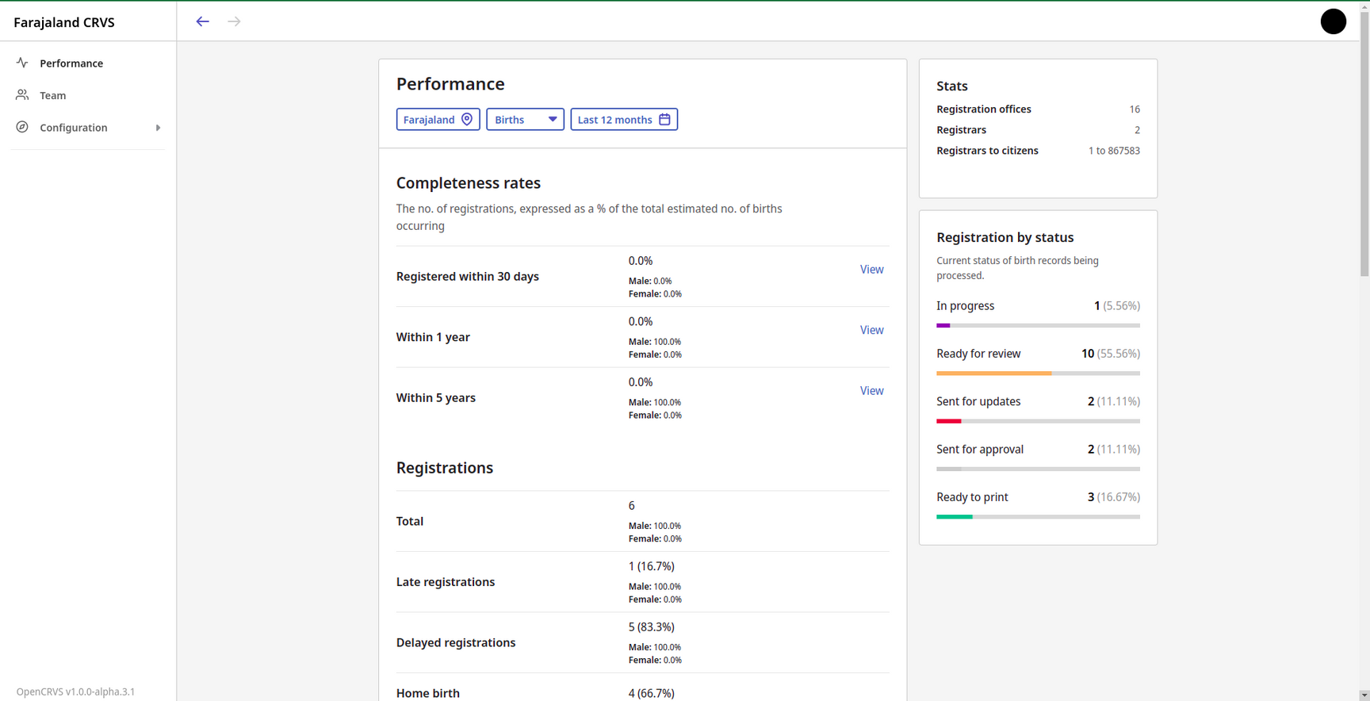
Phase Three

Slide 31
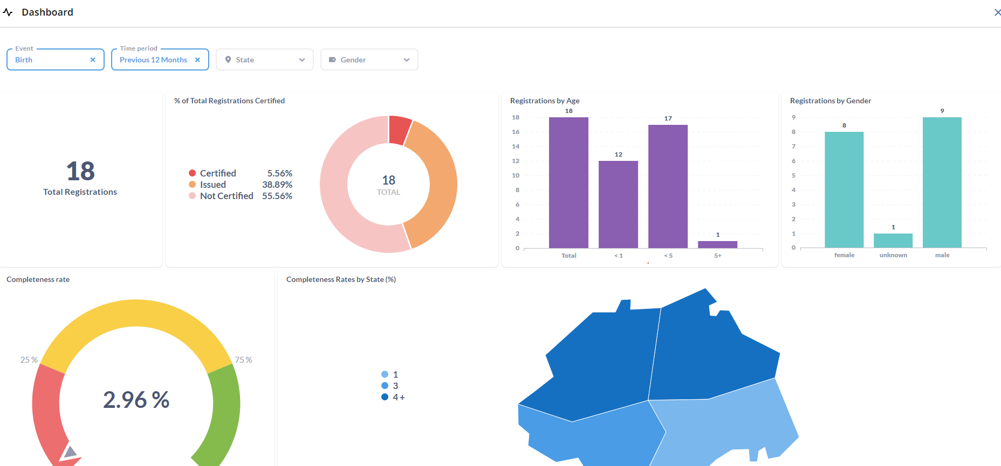
Phase Three

Slide 32
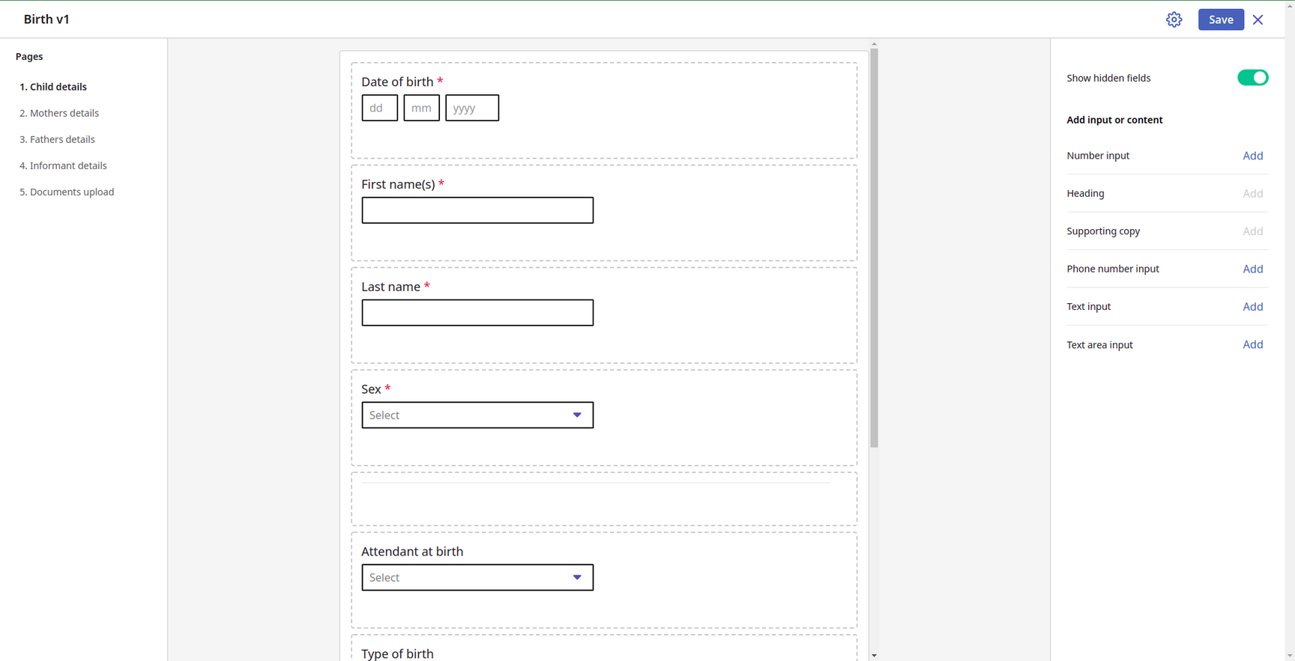
Phase Three

Slide 33
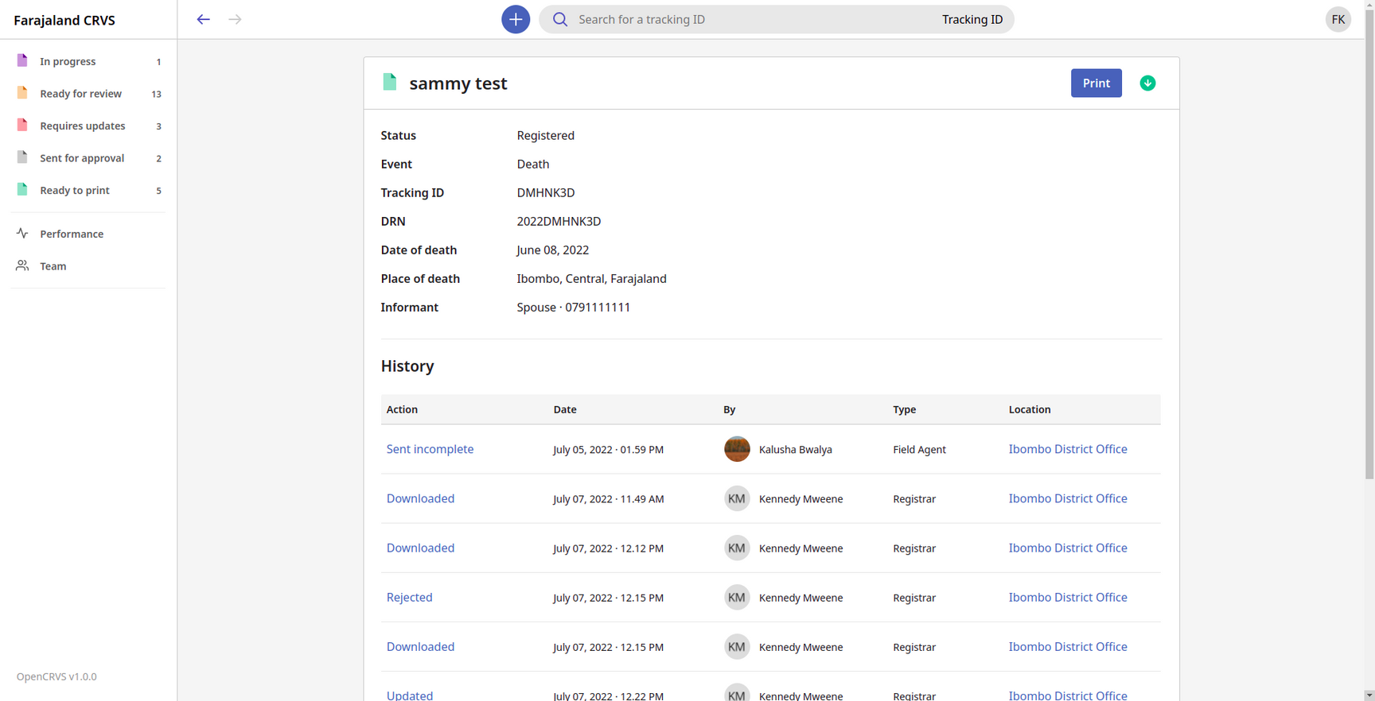
Phase Three

Slide 34
Phase Three
My contributions (Including but not limited to):
Fixed bugs on earlier stages
Refactored entire sideNavigation along with some other components
Worked on the calculation of crude rate
Worked on PWA
Worked on email notification
Implemented some seeding modules
Did some code review

Slide 35
Thank You !

